Slide 1


Data Analysis with Jupyter Notebooks
Konstantina Vasileva
University of Wellington
@konstantinnna | ResBaz Auckland 2020

Slide 2


What are notebooks?
“A Computational Narrative” Brian Granger (Co-creator)
Document & execute code
Embed text, dataviz, multimedia
Open-source
Free
Interactive

Slide 3

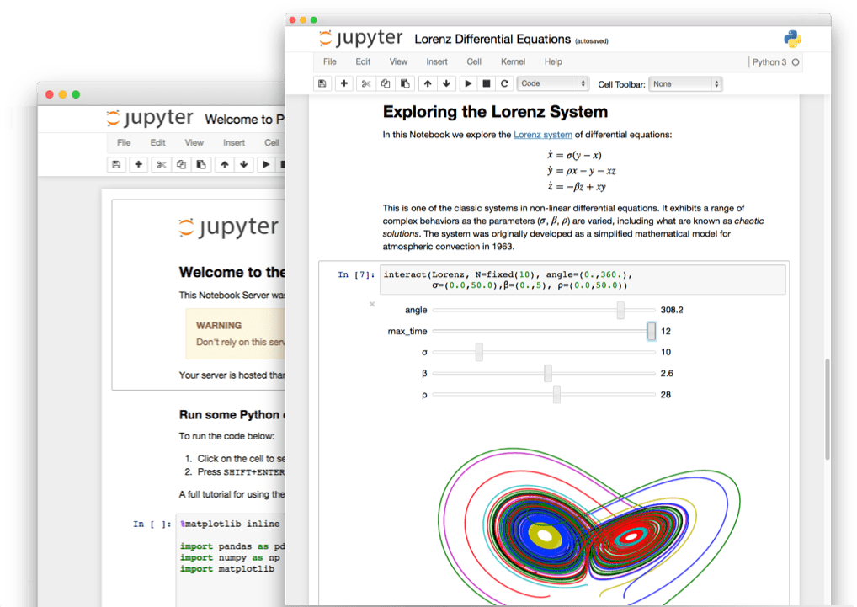
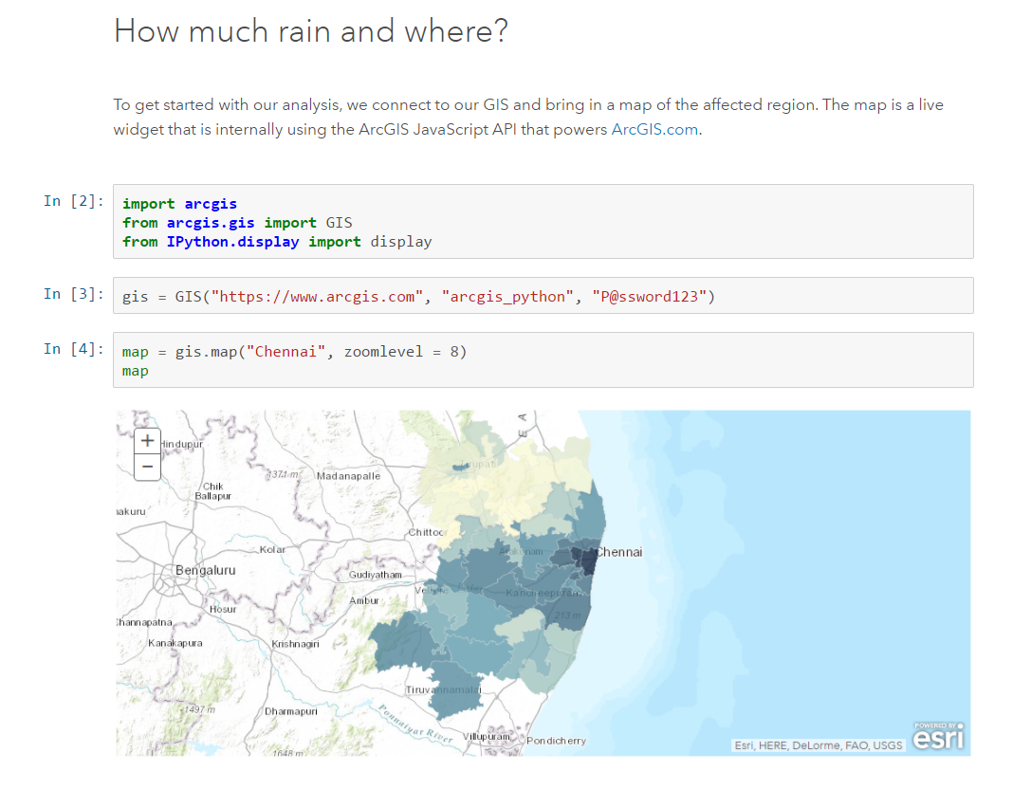
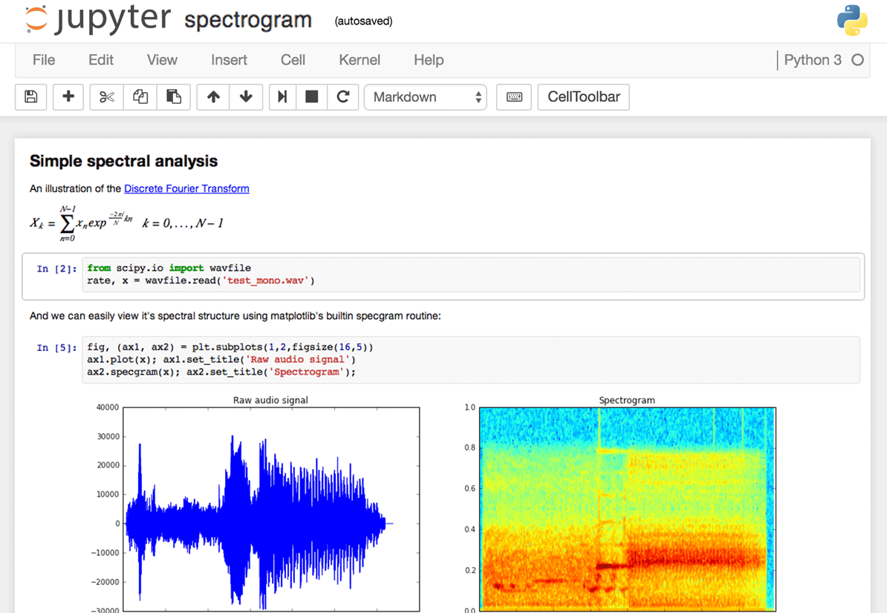
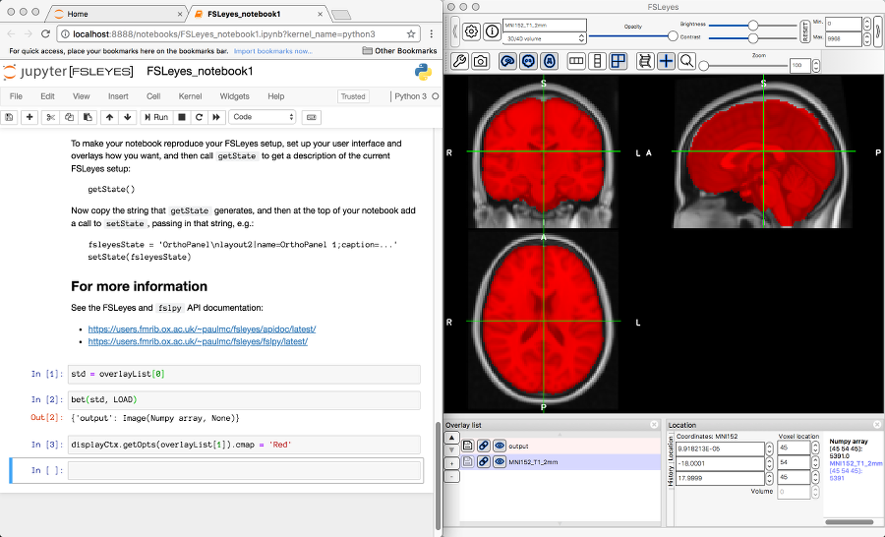
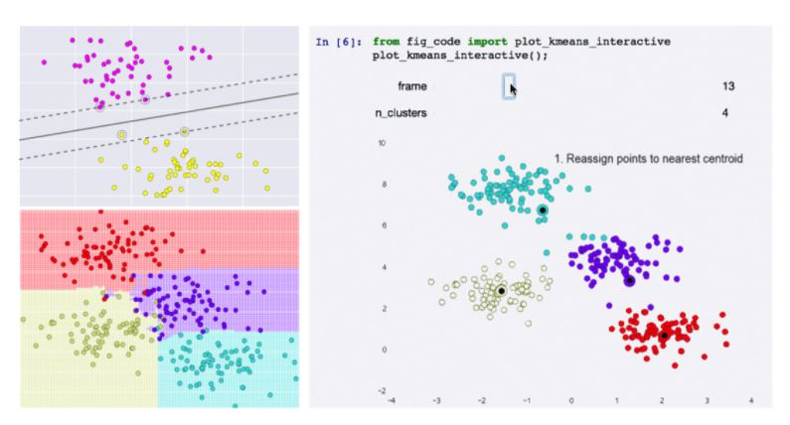
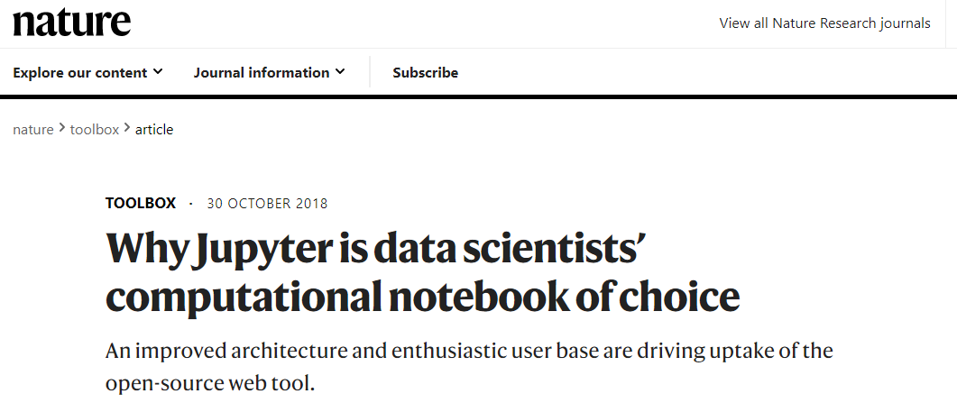
Who can use notebooks?
Data | Science
Academia & Industry
Statistical modelling
Data Science
Machine Learning
Scientific data analysis
Data Journalism

Slide 4

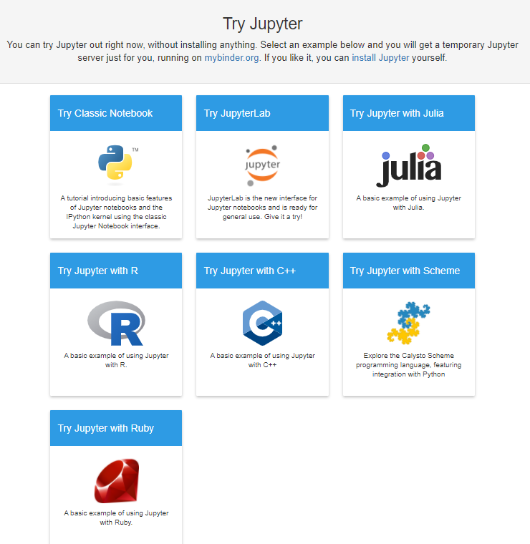





Why ?

Slide 5

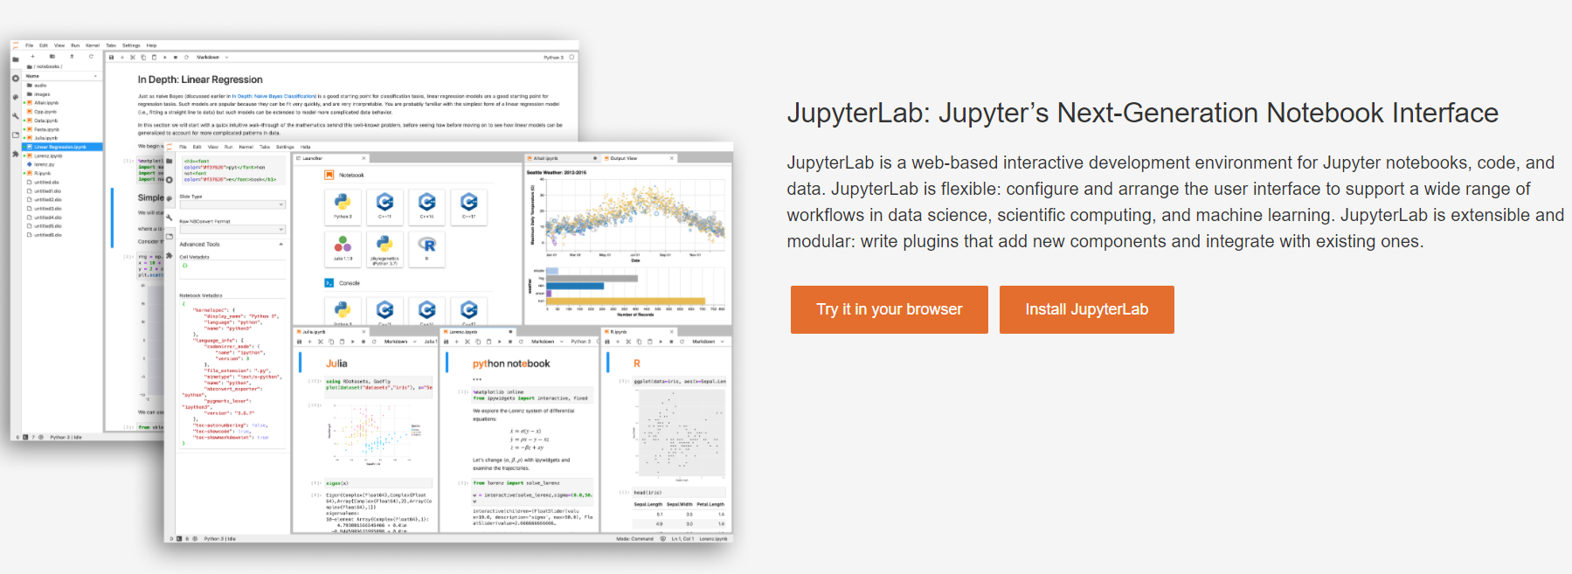
Where ?
https://jupyter.org/try

Slide 6





Where ?
Notes:
Jupyter’s newest variant is JupyterLab, which launched as a beta in January 2018 and is available (like the Jupyter notebook) either as a stand-alone package or as part of the free Anaconda scientific-computing environment.

Slide 7
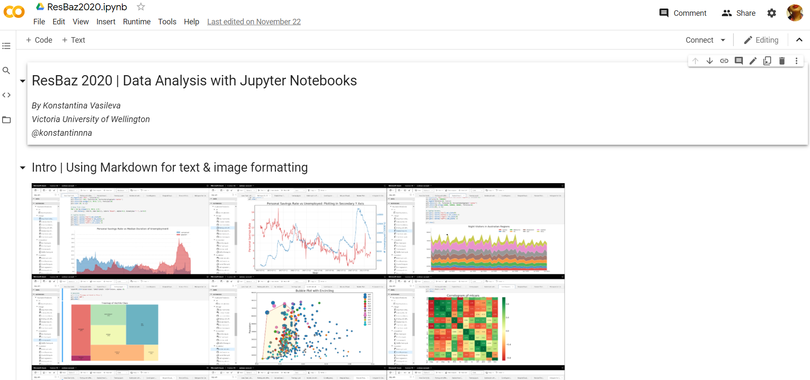
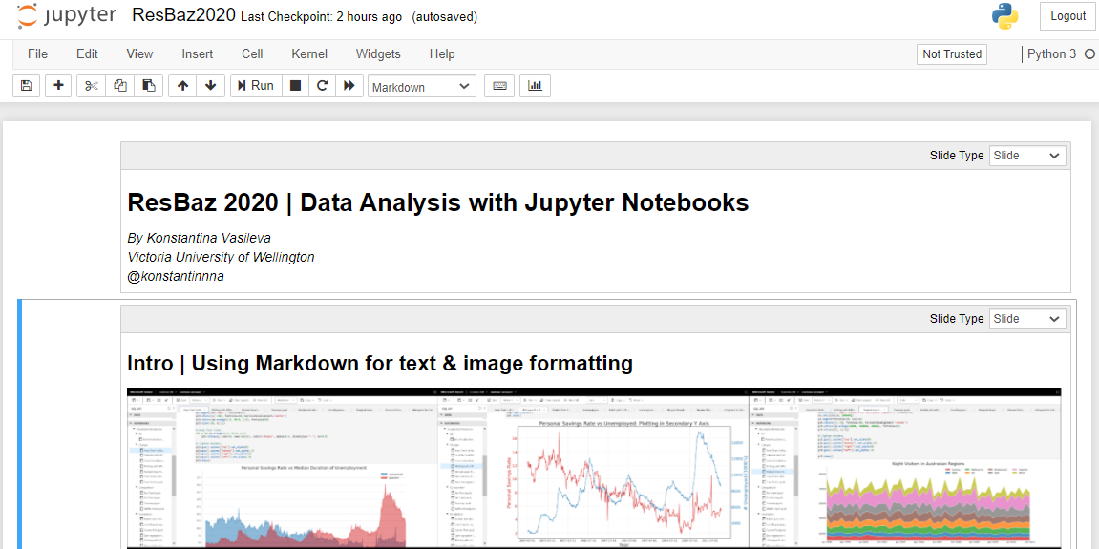
Where ?
Notes:
Jupyter’s newest variant is JupyterLab, which launched as a beta in January 2018 and is available (like the Jupyter notebook) either as a stand-alone package or as part of the free Anaconda scientific-computing environment.

Slide 8

Building
a story
Your Audience
You…
Trust me,
You
Will
Not
remember!

Slide 9
Building
a story
Audience
- Other researchers
- Stakeholders
- Successors?

Slide 10
Building
a story
Ask a good question
Explore the data
Make it relatable
Highlight what’s relevant
Show don’t tell!

Slide 11

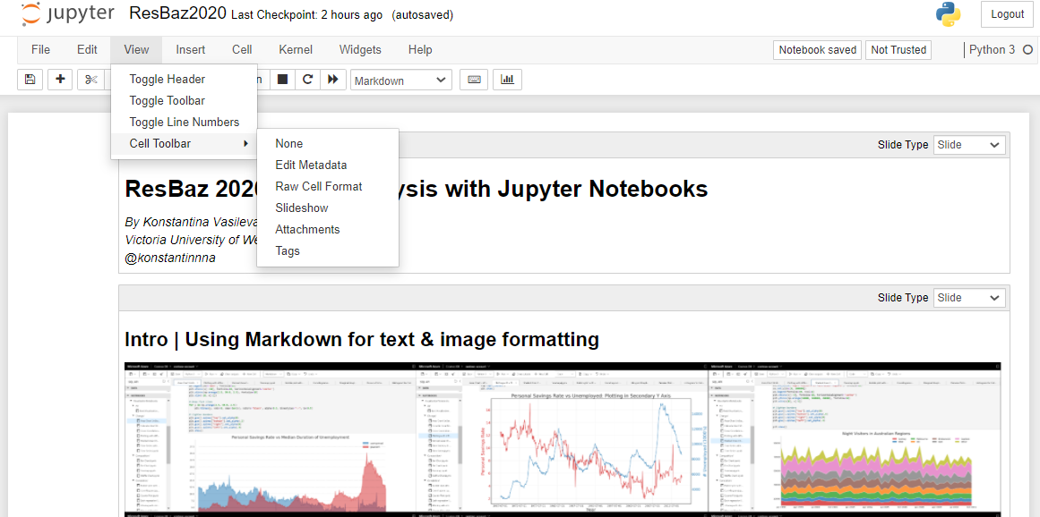

How do I …

Slide 12
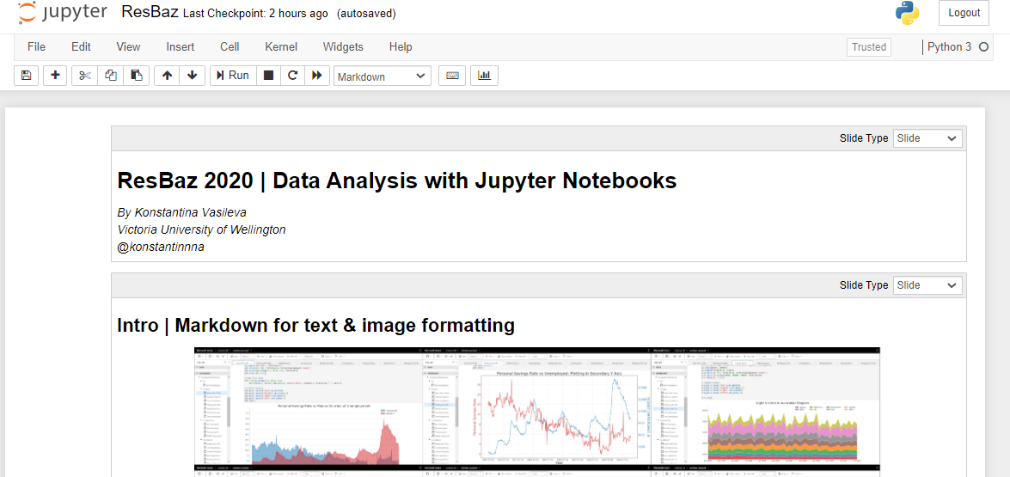
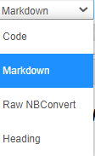
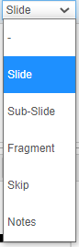
How do I …

Slide 13
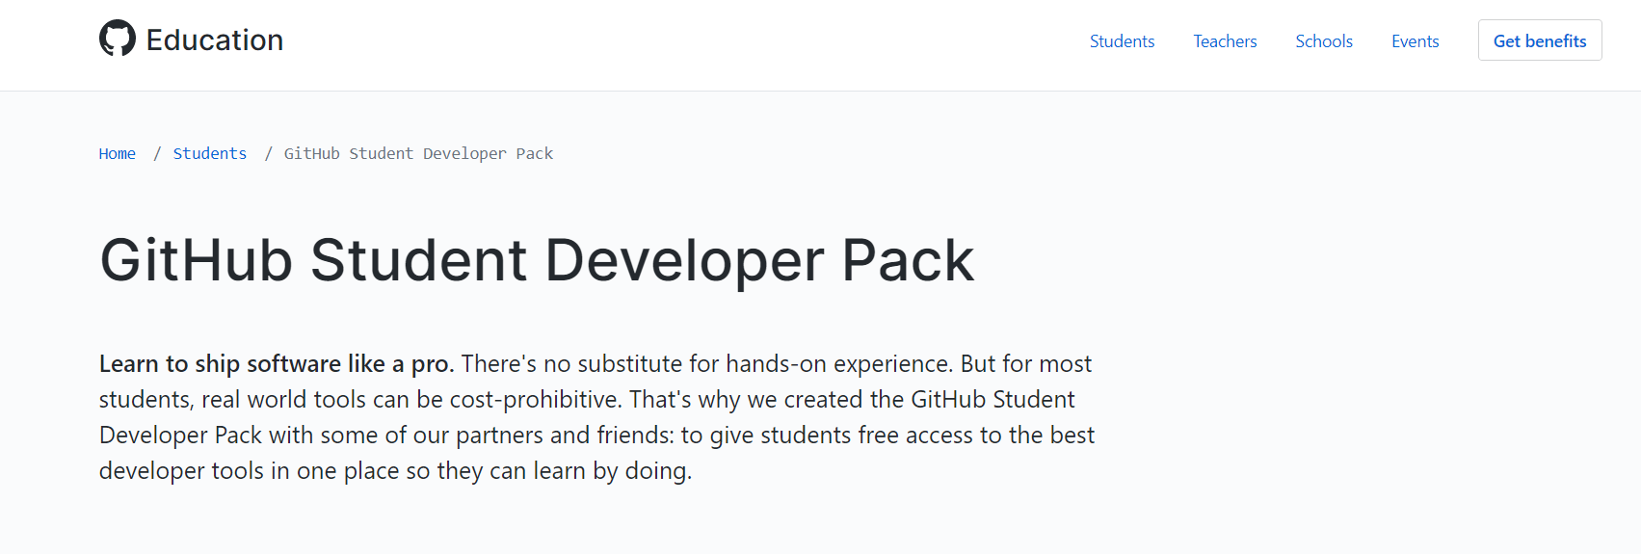

Resources
https://education.github.com

Slide 14

Q&A

Slide 15

If you suck,
Try again.
We all start as…

Slide 16

Thank you!
Konstantina Vasileva
University of Wellington
@konstantinnna | ResBaz Auckland 2020

Slide 17
Appendix | Terms & Tools

Slide 18
Some useful terms
pip | Standard package-management system used to install and manage software packages written in Python
Markdown | Lightweight markup language with plain-text-formatting syntax, created in 2004 by John Gruber and Aaron Swartz. Markdown is often used for formatting readme files, for writing messages in online discussion forums, and to create rich text using a plain text editor.
Notes:
Linting is the process of running a program that will analyse code for potential errors.

